Slide 1
Compability Testing
URL: https://csbc.consisty.com/home
Project Name: CSBC
Microsoft Egde
Mozilla Firefox
Chrome
Created By: Dhwani Parikh

Slide 2
Compatibility Testing on Microsoft Edge Browser

Slide 3
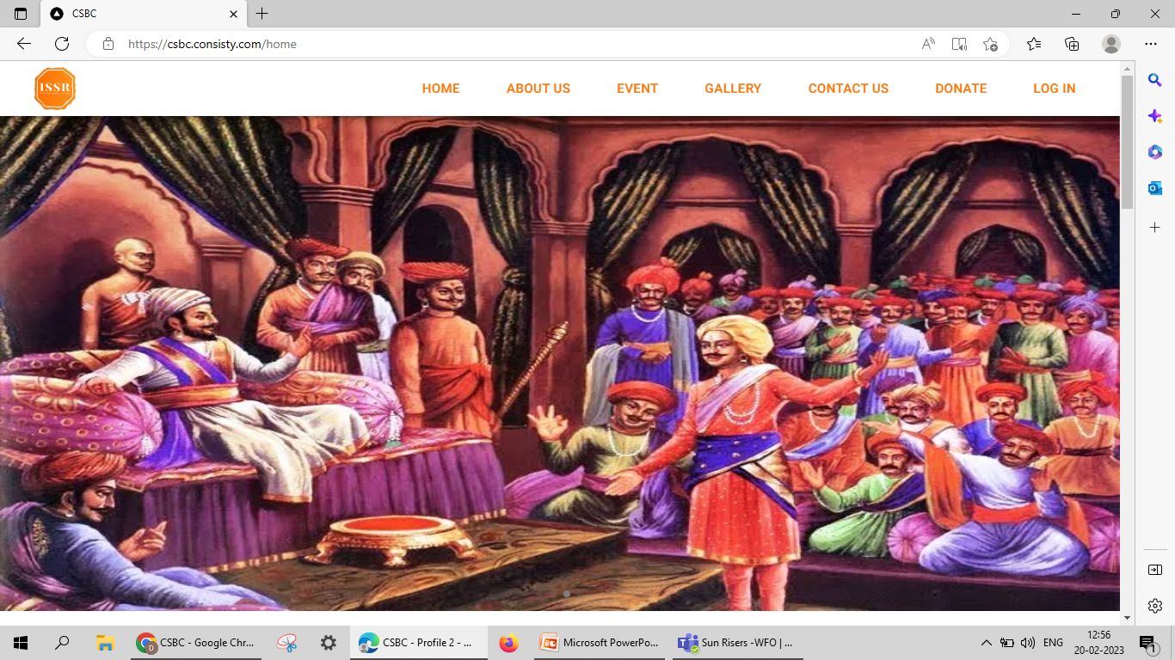
Verify Home page on Microsoft Edge Browser

Slide 4
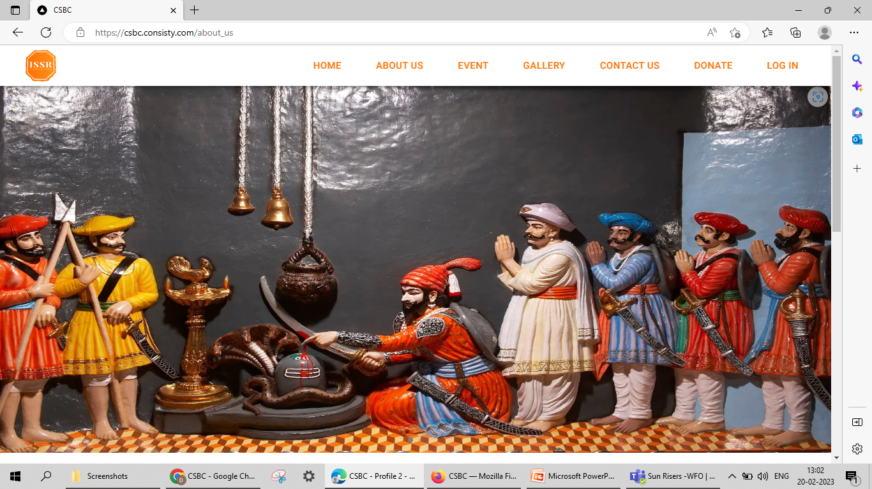
Verify About_Us page on Microsoft Egde Browser

Slide 5
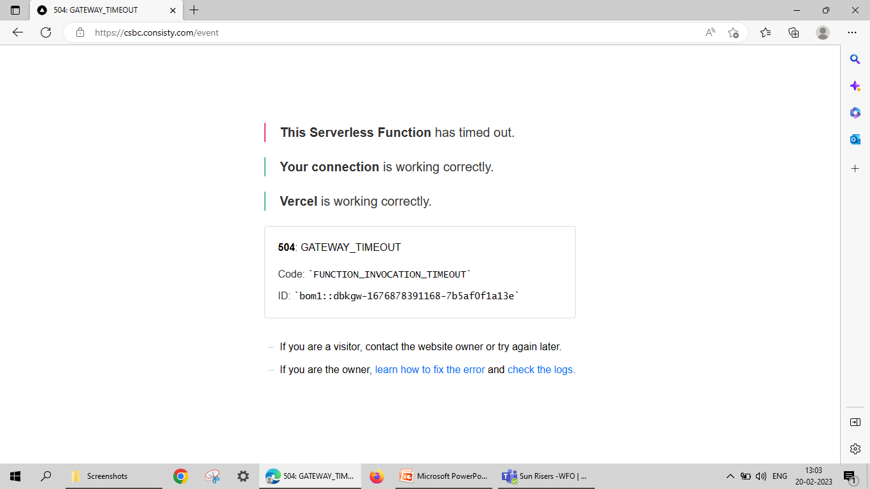
Verify Event page on Microsoft Edge Browser

Slide 6
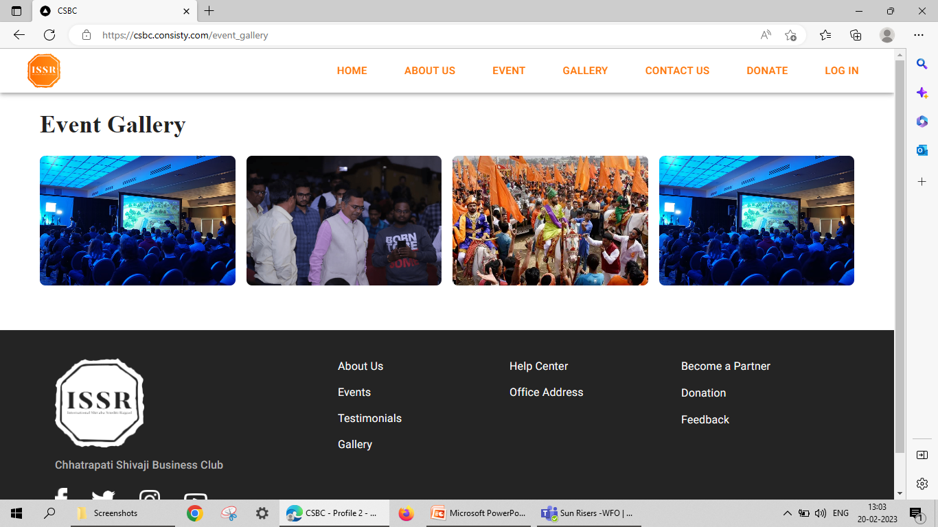
Verify Event_gallery on Microsoft Edge Browser

Slide 7
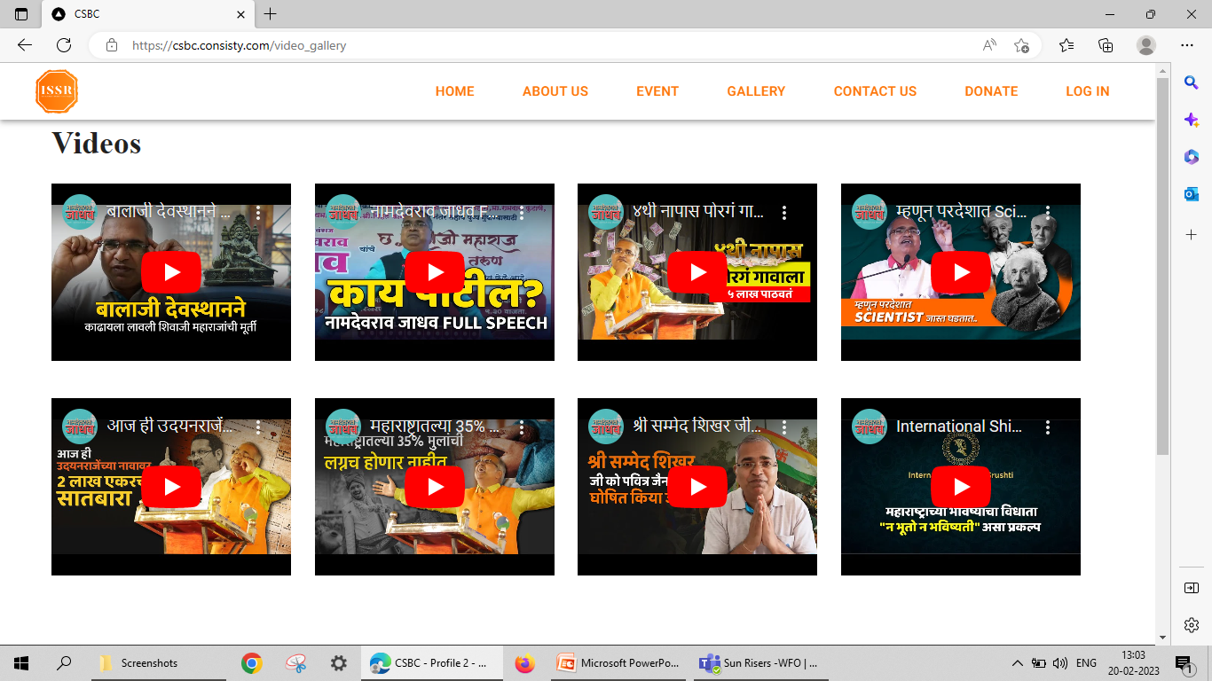
Verify Vidio_Gallery on Microsoft Edge Browser

Slide 8
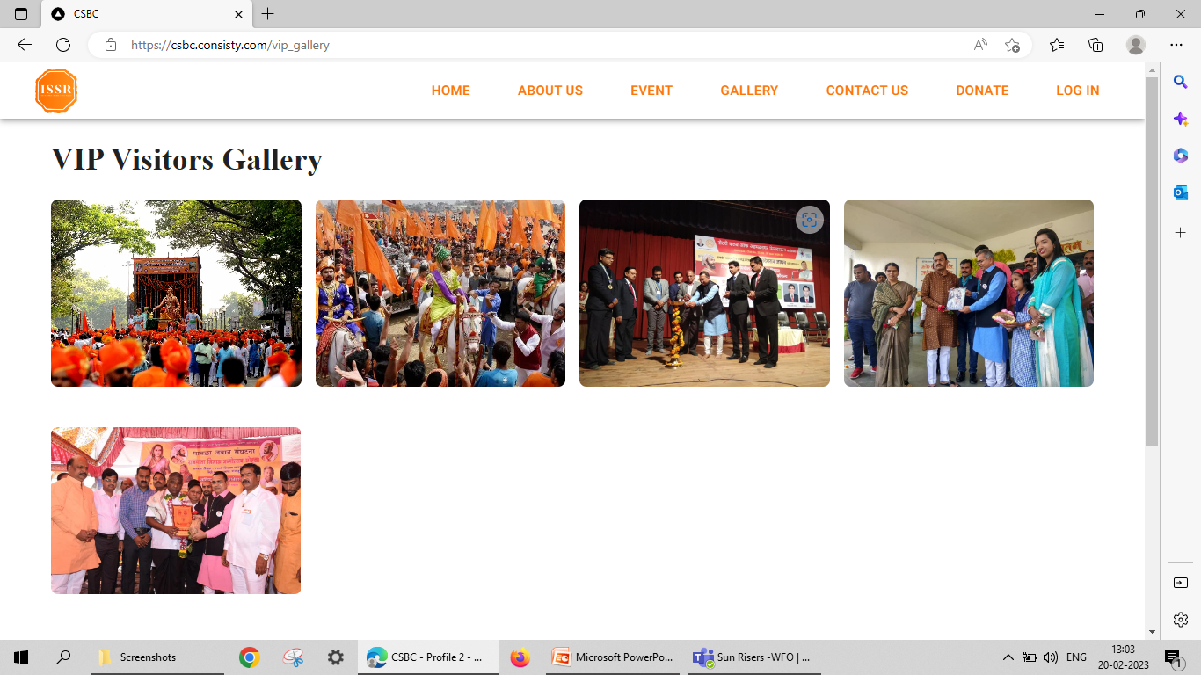
Verify VIP Visitor_Galary on Microsoft Edge Browser

Slide 9
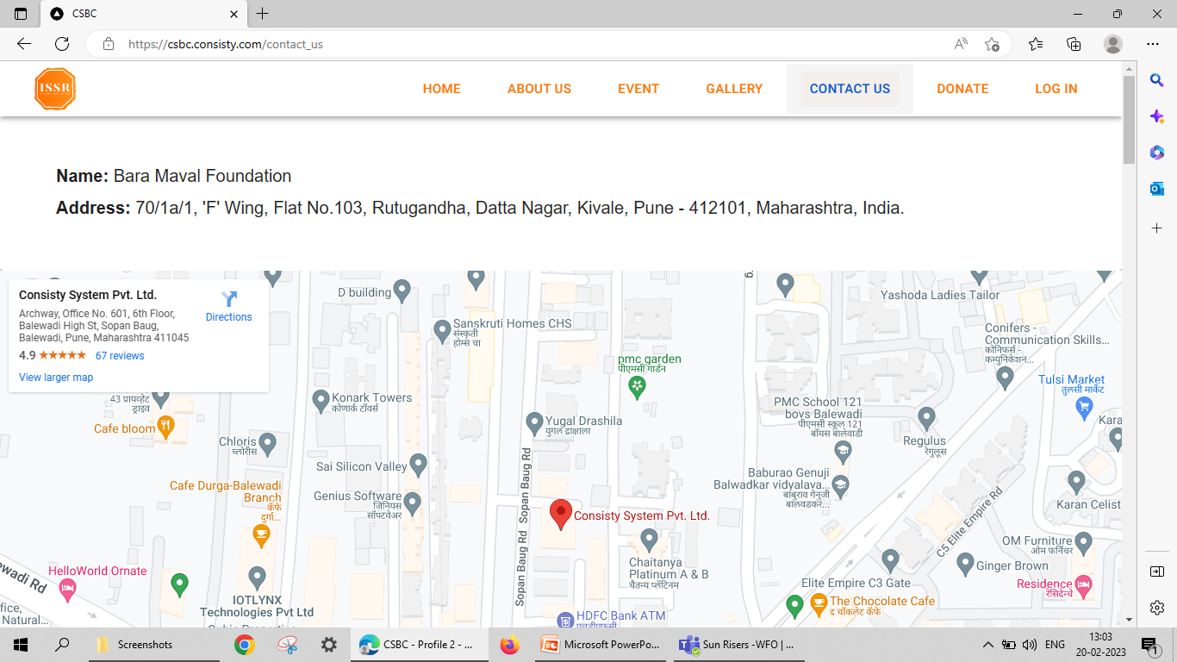
Verify Contact Us on Microsoft Edge Browser

Slide 10
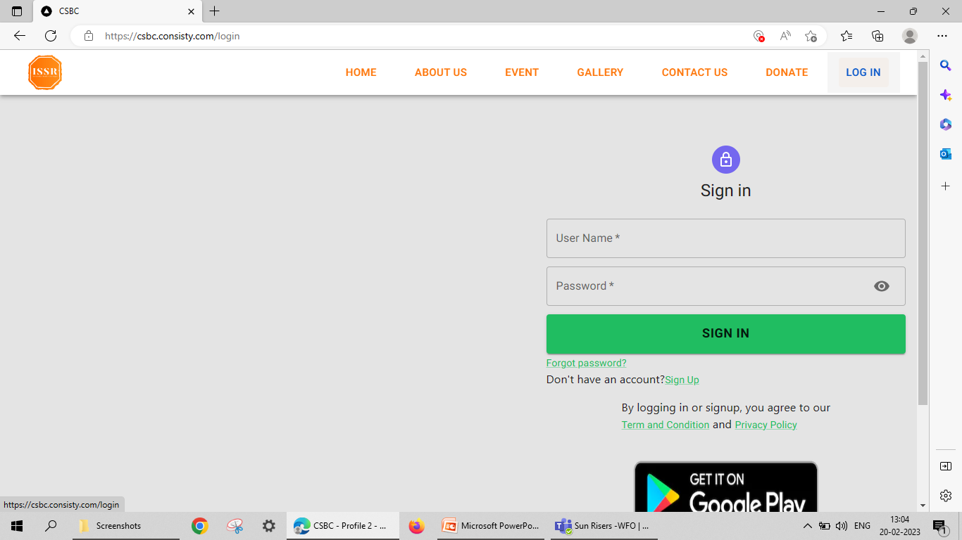
Verify Login on Microsoft Edge Browser

Slide 11
Compatibility Testing on Mozilla Firefox browser

Slide 12
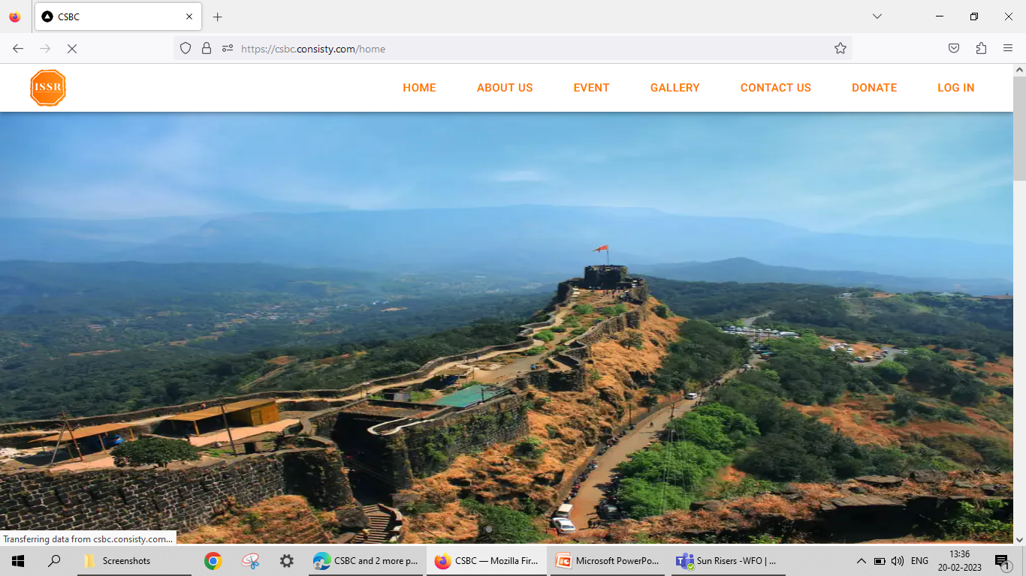
Verify Home page on Mozilla Firefox Browser

Slide 13
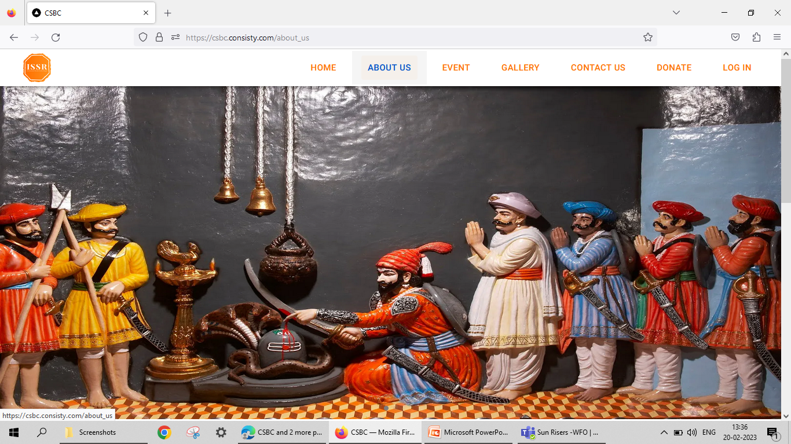
Verify About_Us on Morilla Firefox Browser

Slide 14
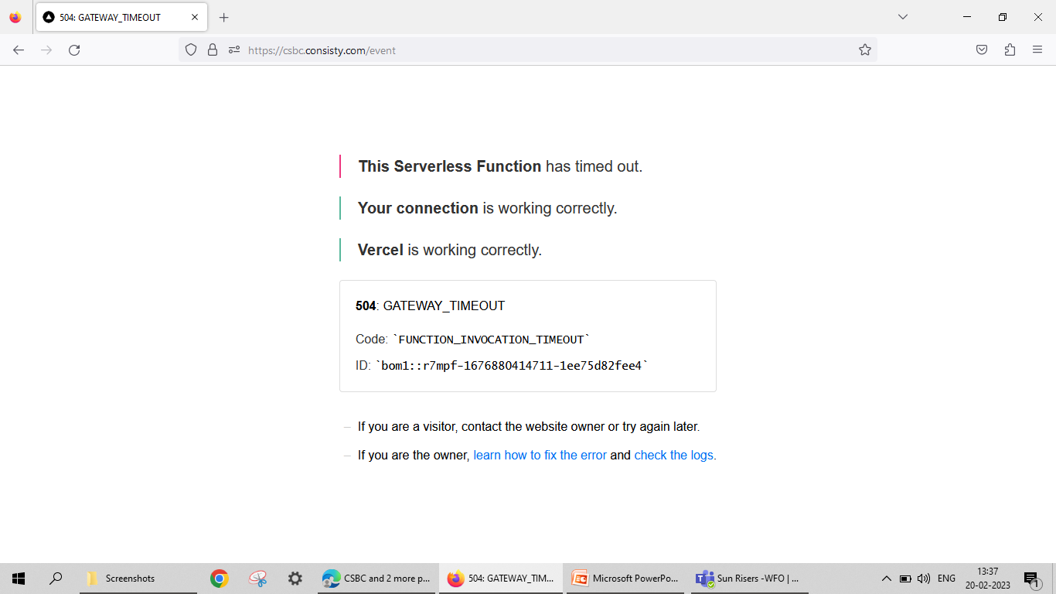
Verify Event on Morilla Firefox Browser

Slide 15
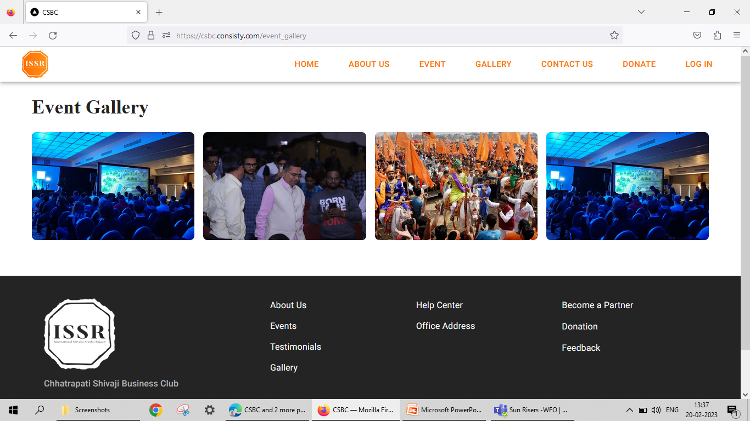
Verify Event_Galary on Morilla Firefox Browser

Slide 16
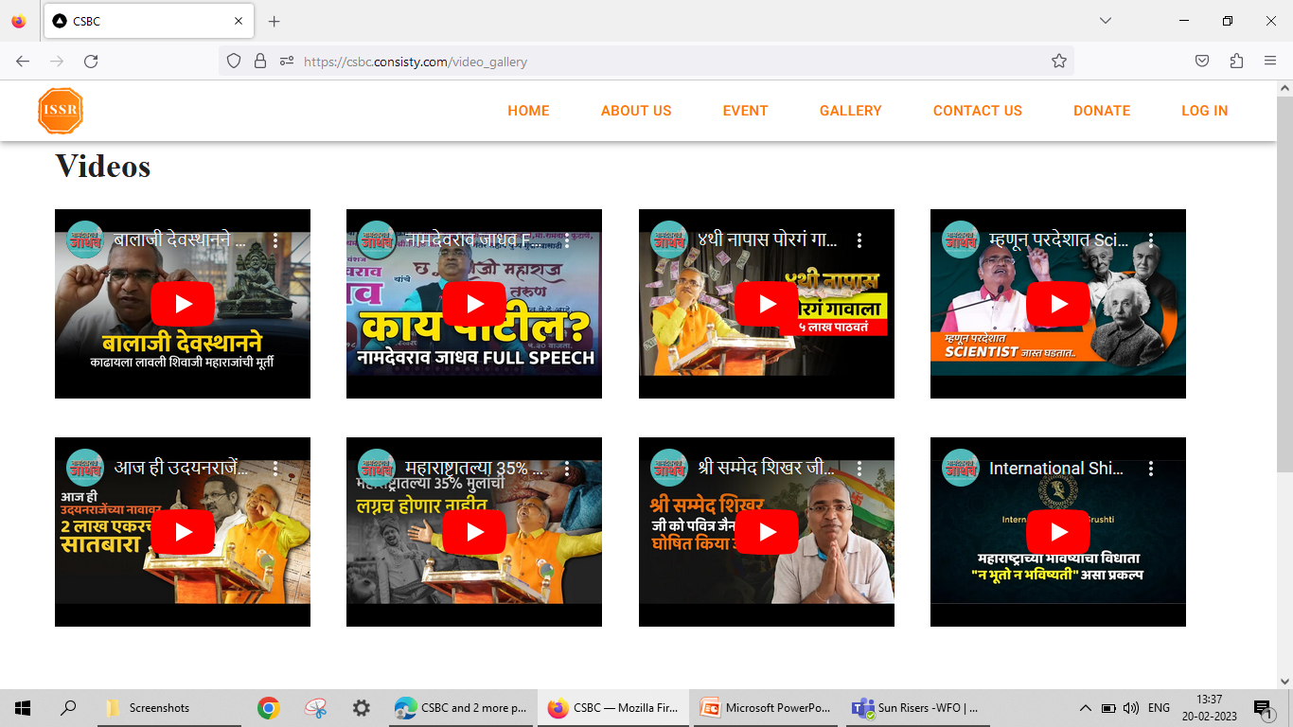
Verify Vidio_gallery on Morilla Firefox Browser

Slide 17
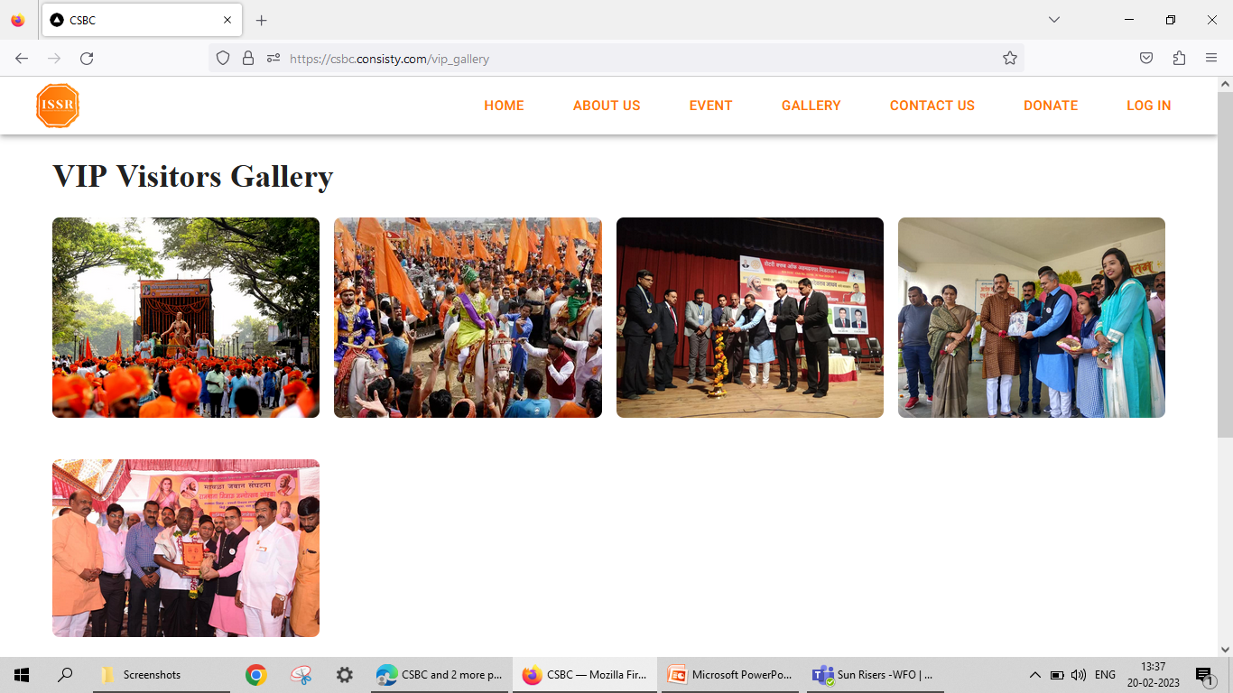
Verify VIP_Visitor_gallery on Morilla Firefox Browser

Slide 18
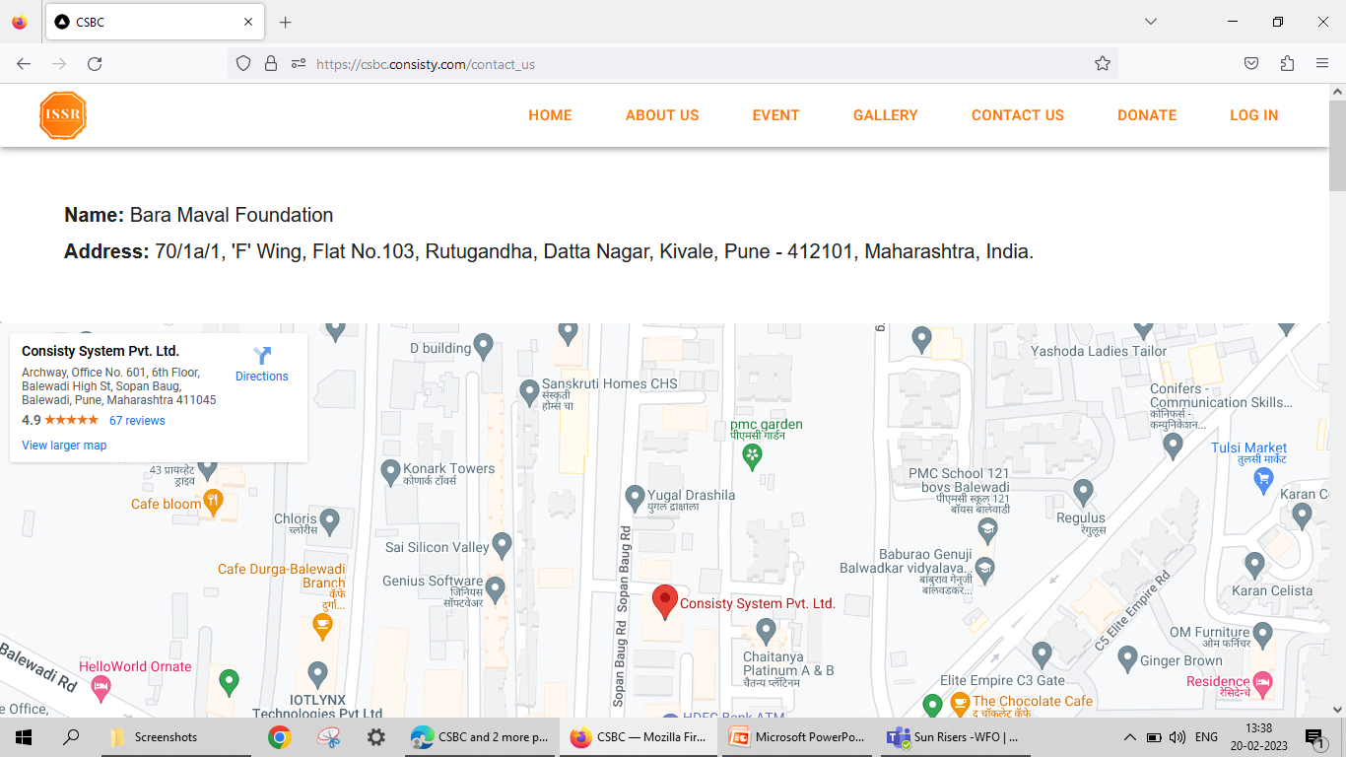
Verify Contact_Us on Morilla Firefox Browser

Slide 19
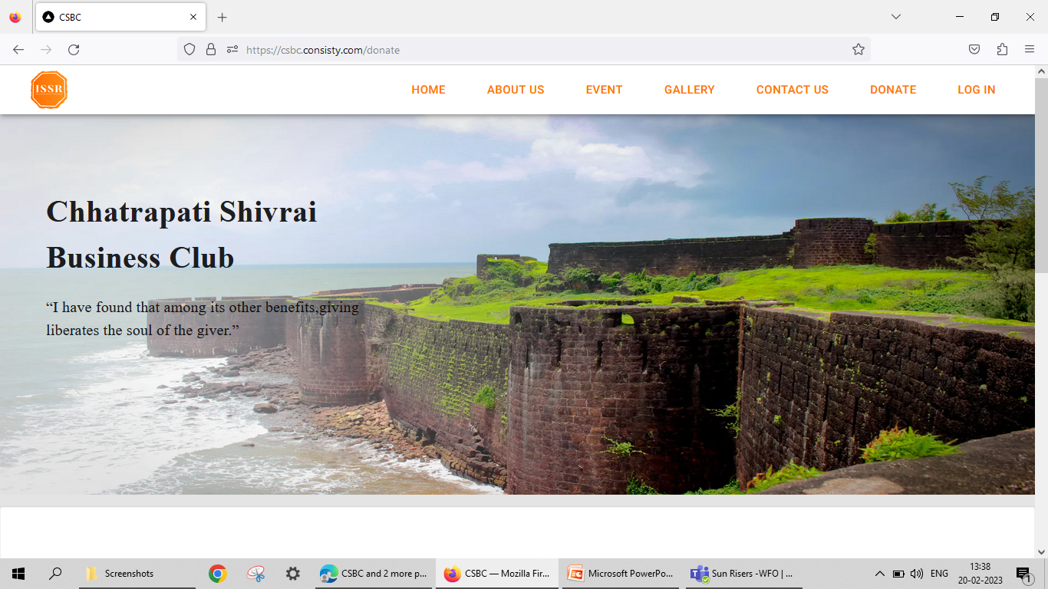
Verify Donate on Morilla Firefox Browser

Slide 20
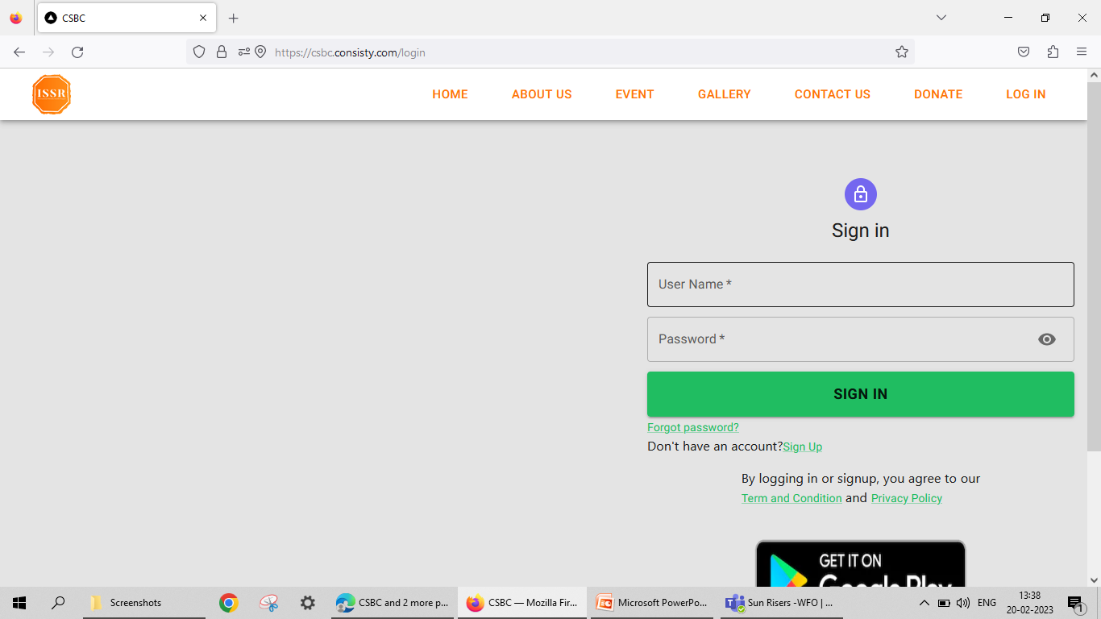
Verify Login on Morilla Firefox Browser

Slide 21
Compatibility Testing on Chrome Browser

Slide 22
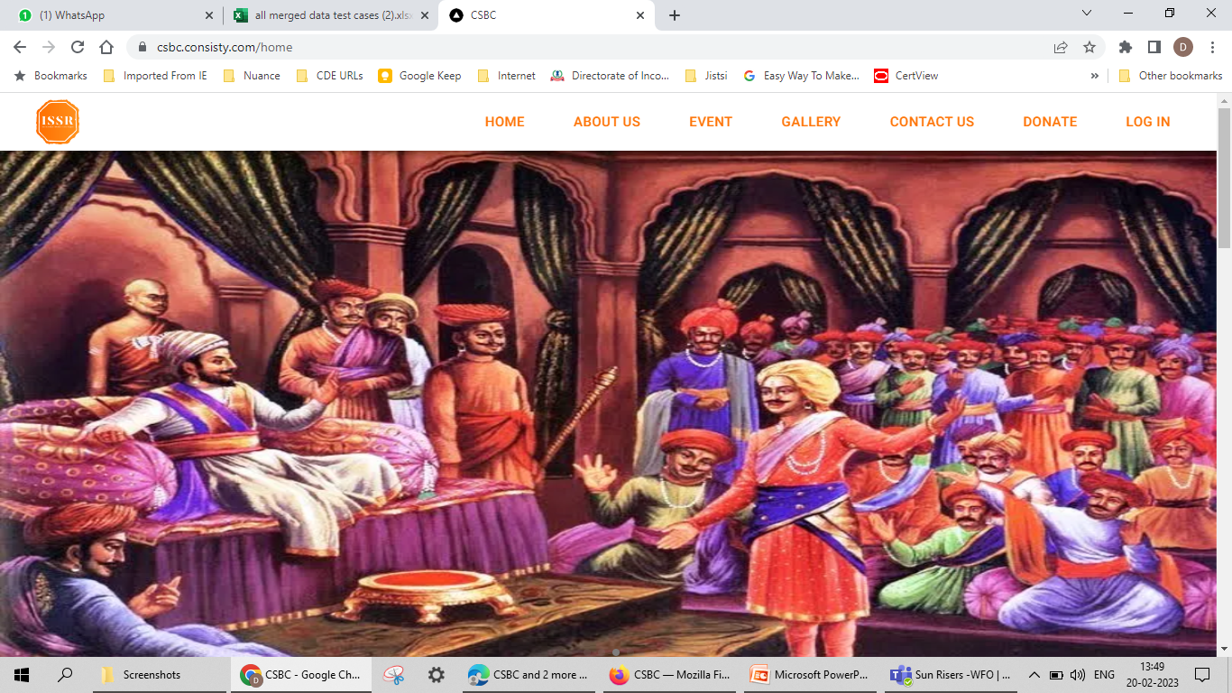
Verify Home page on Chrome Browser

Slide 23
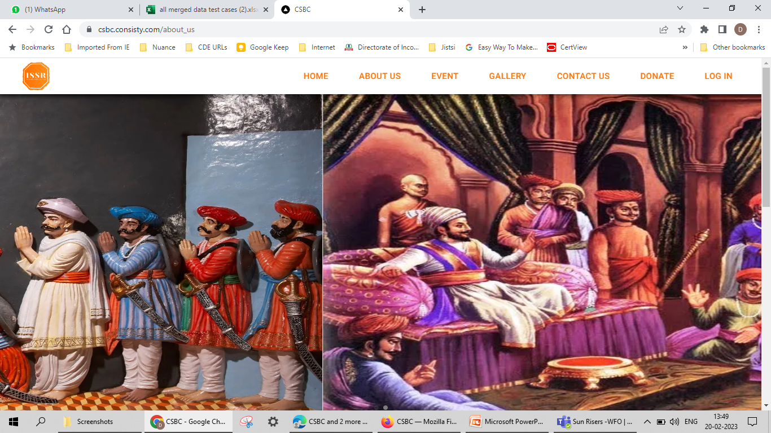
Verify AboutUs on Chrome Browser

Slide 24
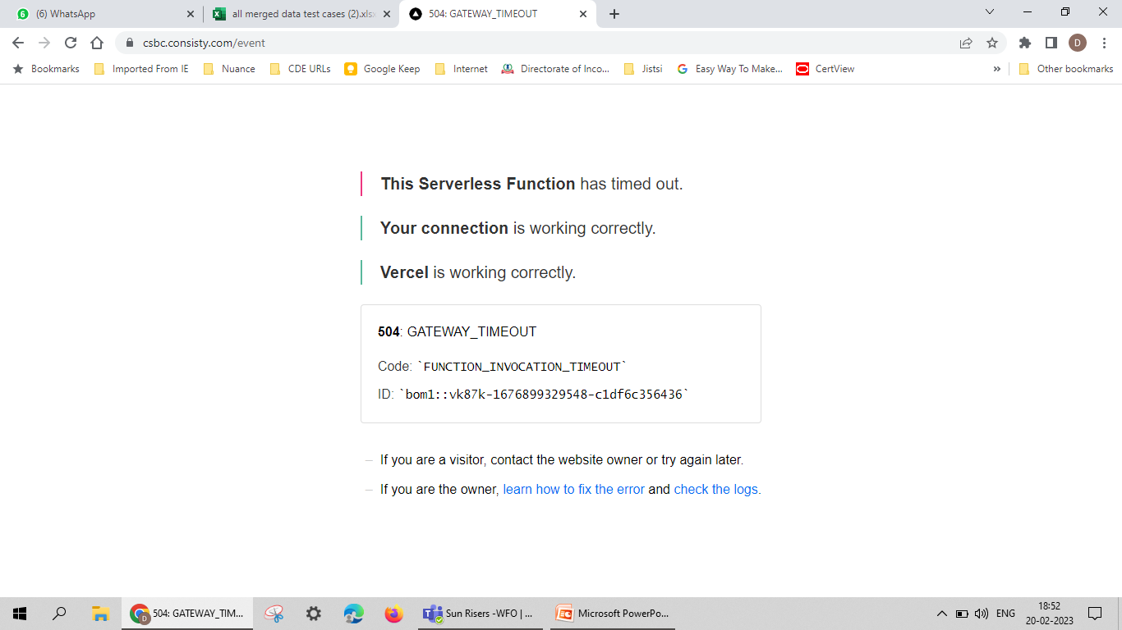
Verify Event page on Chrome Browser

Slide 25
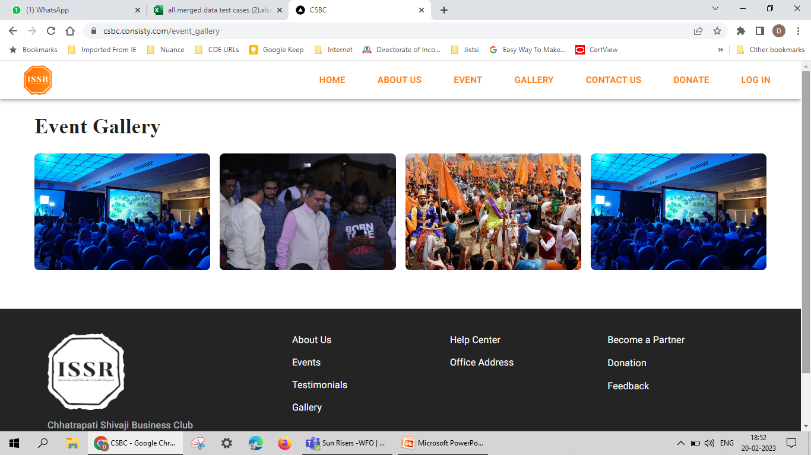
Verify Event _Gallery page on Chrome Browser

Slide 26
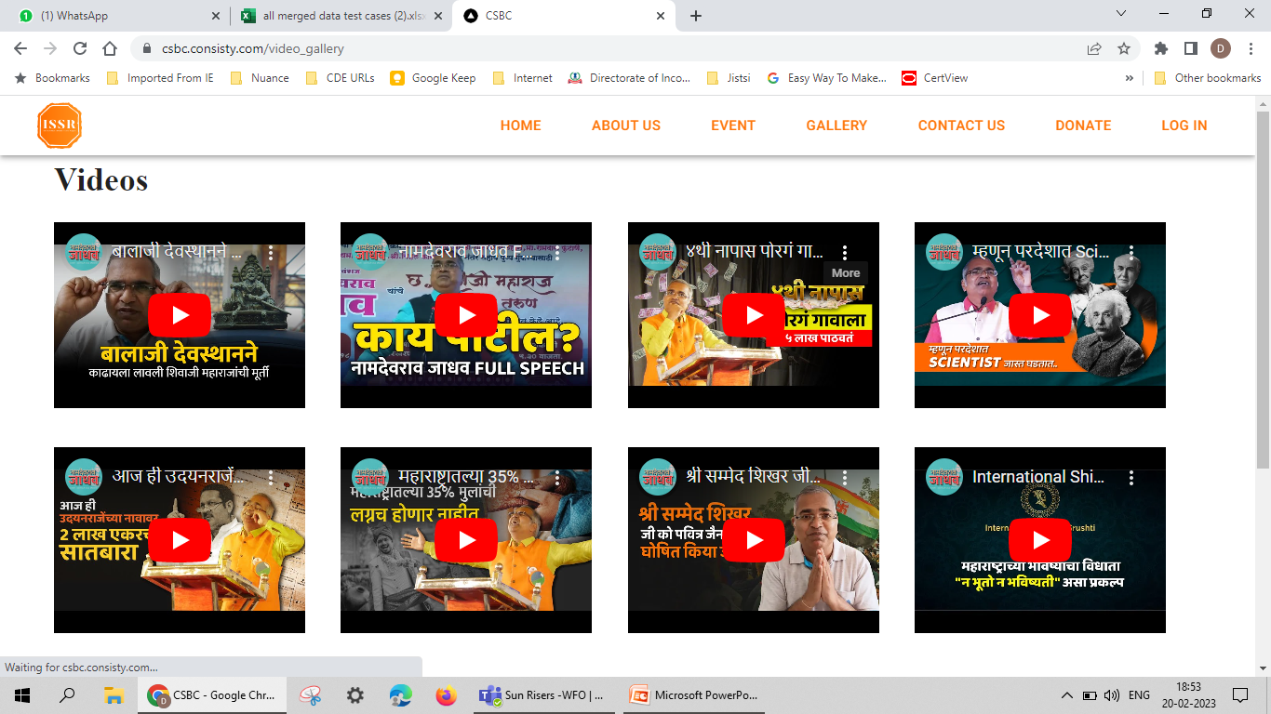
Verify Vidio_Gallery page on Chrome Browser

Slide 27
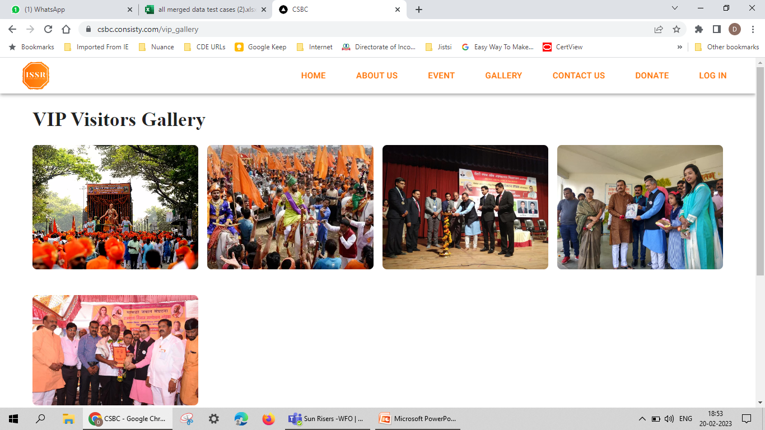
Verify VIP_Visitor Gallery page on Chrome Browser

Slide 28
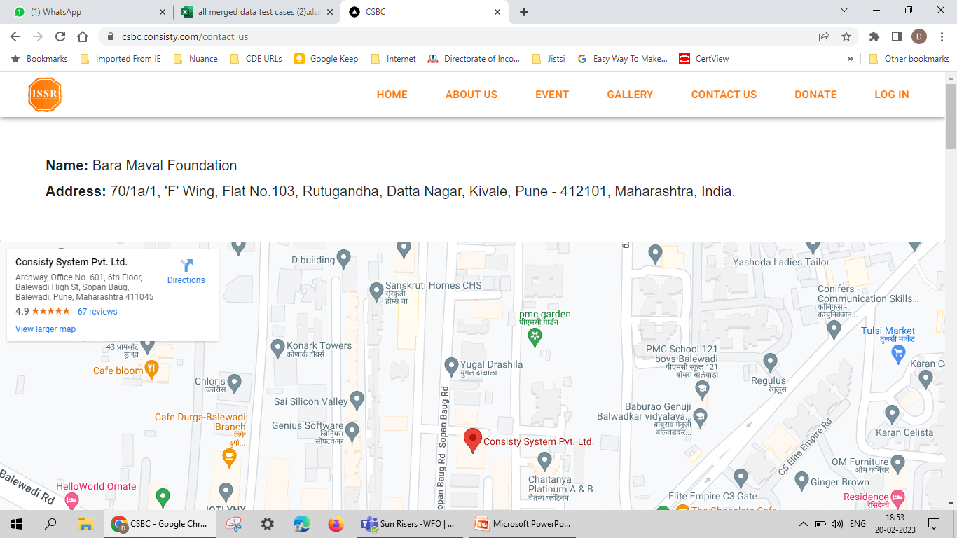
Verify Contact_Us page on Chrome Browser

Slide 29
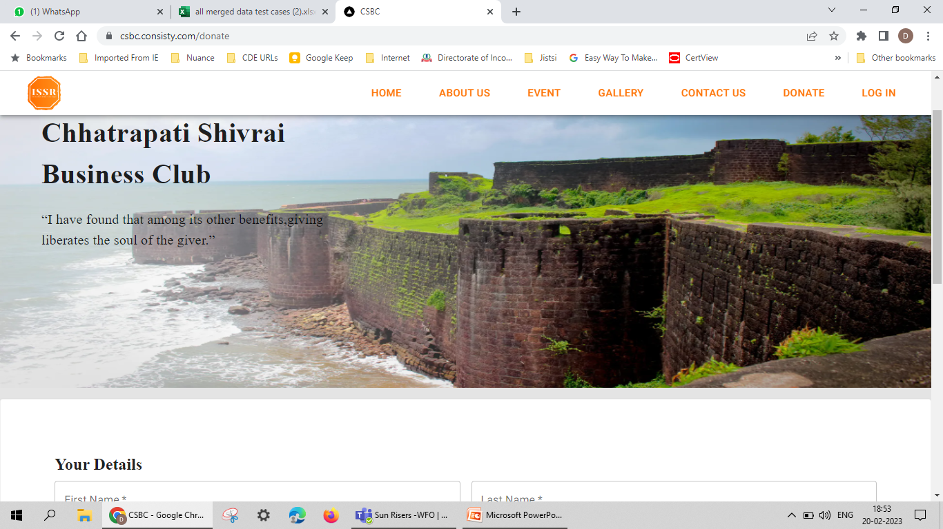
Verify Donate page on Chrome Browser

Slide 30
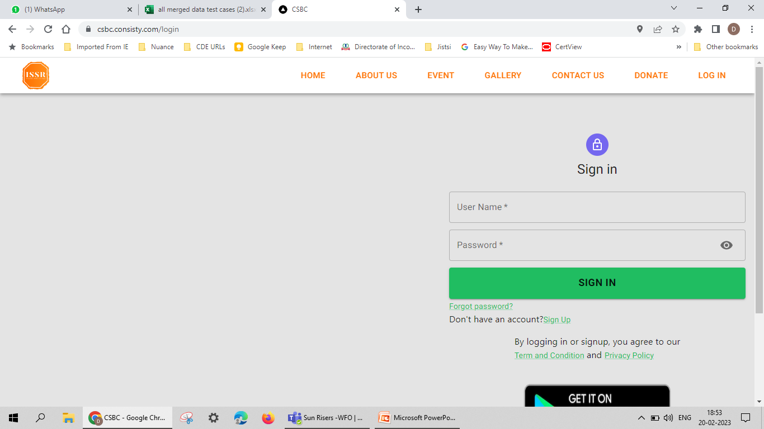
Verify Login page on Chrome Browser

Slide 31
Thank You

